Slide 1

<MILLER MEDIA GROUP>
Apoorva Jain
1.10.2017
Case #2
Prepared for
EMIS 7360

Slide 2
Publish it under one !! More effective, More revenue !!
Background
Overview of Business
Miller media group is a $55m company of distribution and publishing niche magazines and advertising vehicles.
Headquarter of the company is in Lafayette, Louisiana.
It have various sales office across USA, Denver, Phoenix, Minneapolis..
It was founded back by John Miller in 1959.
Present CEO of the company is James, John Millers son’s .
The company is of 220 employee.
Some magazines are distributed free to target the readership and some are available via subscription for some price.
Magazines have almost 50000-200000 circulation that too monthly or quarterly.
Magazines has a separate identity by a separate business unit that are as follows:
1.Rocket Magazine
2.Gravel times
3.Fly Fisherman
4.Billiard Gazette
5.BMX Central
6. The Arborist

Slide 3
Background
The senior management of the company is been with the company almost for 10 years.
However the company is small but won several awards such as 3rd party recognition for excellence in inventing and reporting.
The publications have a web presence but of a subset.
Some of people talk about pushing towards digital media.
Overview of IT
The IT director is Bill Reynold, he has already done some IT management role before.
Bill reports to the COO, Ram Singh.
It’s a group of 45 employee who is working under Bill.
Compensation of IT staff is $2,301,330.
Applications run on Windows and SQL
Websites for each magazine is written in HTML and Visual Basics.

Slide 4
BILL, IT department is slow we need your help act aggressively, PLEASE .! Save us, everyone like us .
Findings
The average profit margin is $5.5M.
  Its stated that the company has a business of $55M.
The average profit margin is expected to be $6.0M.
  Its stated that the company expects a business of around $60M.
The Applications run on pretty old software updates.
  Its been stated that they use MS exchange 2003, Work on visual basics and HTML etc.
The IT director should be aggressive.
  The COO states that Bill should be aggressive in management decisions.
We have 45 people working in IT team.
  As shown below in the figure.

Slide 5
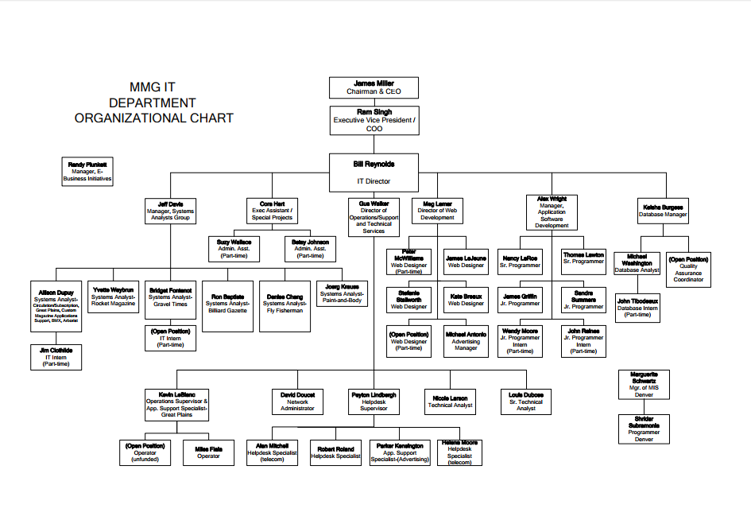

Slide 6
Annual budget of IT should be approx. $1.8M/annual.
  Annually an average spending on IT is 3.2-3.5% of the revenue
Annual budget of IT should be approx. $1.9M/annual.
  Annually an average spending on IT is 3.2-3.5% of the revenue.
  As they projected that there revenue will be $60M.
They spent more than there budget is on IT.
  Its stated that is equivalent to $2,301,330.
They do not have a great record of completion of project on time.
  The COO states that they don’t have a good record in completing the projects on time.
The IT people are very slow.
  Senior Vice president stated that they are slow while completing the critical projects.
  Even the Manager also stated that they are less efficient.

Slide 7
HURRY! EFFICIENT STAFF NEEDED , UPDATE THE SYSTEMS AND WORK LITTLE FASTER.
Recommendation
They should start exploring the digital public side.
  That will increase there popularity which will effectivly change in revenue.
They should decrease the projected compensation of the IT staff.
  Its been stated that the revenue is just $60m which is been projected and according to that the IT budget should be around $1.9M but here they are spending around $2.3 M.
They should appoint a director with more experience in managing the IT department.
  They should appoint a person with more experience in managing a big team around 50 people.
  Who is has a great decision sense, which will help the company in there own critical time.
Update there systems.
  There web applications are made on HTML, Visual basics etc, as it will make there team work more faster if they go hand in hand with technology they should use JAVA Script, CSS etc.
  Update there system to the latest time so that they can work efficiently and save time so that can complete projects on time.

Slide 8
They should do the publishing under one company.
  By digitalizing the revenue will be increased and if they do publishing in tons it will increase the revenue and reduce the costing price which will save some money.
They should lessen the number of magazines sold for free.
-They are spending a lot on magazines which are sold for free which is indirectly costing much, rather then spending on that spend on person who is indulged with the new software's skillset.
They should hire more competent people in IT.
-There should be highly skilled person rather then too many inefficient person, here there are around 45 people working but they are not useful while completing the projects on time so they are not that useful, so better to cut people and hire some efficient people so that they at least complete projects on time and hence generate great revenue.

Slide 9
Working notes
Working Notes
1 – 10% is generally profit that is equal to $5.5M.
2 – 10 % is the profit, but the revenue is expected to be around $60M so that is equivalent to $6M.
3 – 3.2% is minimum IT budget of revenue that is $1.8M
4 – 3.2% is minimum IT budget of revenue when its expected to be $60M then it is $1.9M
5 – There should be more effective staff though they have more number of staff but aren’t competent.

